Slide 1

Characterizing Non-Hodgkin’s Lymphoma with Patient Level Clinical Trial, Biomarker, and Real World Data
Joseph N. Paulson PhD

Slide 2
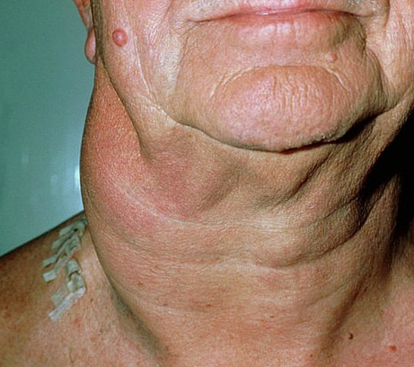
Non-Hodgkin Lymphoma: A Beginner’s Guide
What are NHLs?
A diverse group of cancers that develop in the lymphatic system (a network of tissue which includes the lymph nodes, bone marrow, spleen and thymus)
The majority arise from a type of white blood cell called B cells
NHLs can be classified according to how quickly they progress:
DLBCL and FL account for the majority of all NHLs
Lymphomas
NHL (85%)
B-cell NHL (85%)
T-cell NHL (15%)
HL (15%)
Indolent
Follicular lymphoma
Marginal zone lymphoma
Aggressive
DLBCL
Mantle cell
Very aggressive
Burkitt lymphoma
B-Lymphoblastic
Edward Bataillard

Slide 3
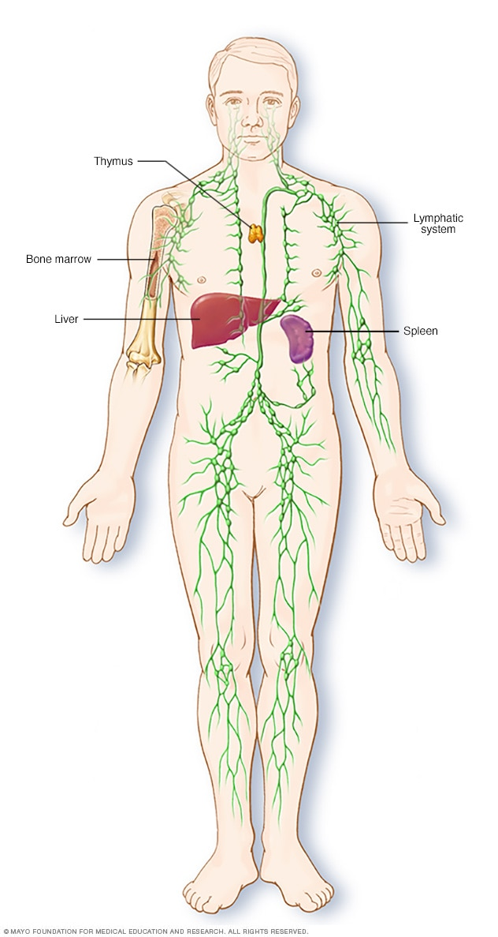
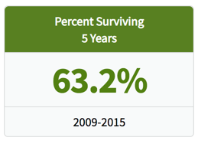
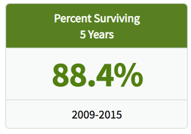
Non-Hodgkin Lymphoma: An Overview
74,200 cases a year in the USA
Diffuse Large B-Cell Lymphoma
(DLBCL) ~ 35%
Follicular Lymphoma
(FL) ~
R-CHOP
R-CHOP
60%
40%
90%
10%
Cure
Relapse
Maintain
10 year PFS
25%
75%
Rescue
Death
Patients who fail 1L (relapsed/refractory) have the worst outcomes, regardless of gene expression.
Notes:
This exploratory analysis focuses on DLBCL. Being the more aggressive disease, there is a definite unmet need for patients who relapse after R-CHOP ( ~40% of DLBCL patients).
Currently, Roche looks at patient subgroups using biomarker data. Using the Hans algorithm which analyses histochemical expression to predict survival, there are two subtypes of DLBCL patients present. Patients which are classified as GCB (Germinal Center B-cell) have much better prognosis than ABC (activated B-cell). In addition to this classification, there are double hit patients which overexpress MYC and BCL2, (5-10% of all patients), which also have poor prognosis.
An important thing to note is that DLBCL and FL are highly heterogeneous diseases, and patients do not cleanly fall into one or the other. Therefore, it is a challenge predicting prognosis and there is an unmet need to address patients who do not neatly fit into these categories.

Slide 4
Diffuse Large B-Cell Lymphoma
What factors influence prognosis?
Prognostic scores:
IPI (pre-Ritux era)
R-IPI (post-Ritux era)
NCCN-IPI
Biomarkers
MYC and BCL2 and/or BCL6 gene rearrangements (“double/triple hit lymphoma”)
MYC and BCL2 overexpression (“dual expressors”)
Cell of origin (COO) according to gene expression profiling
Germinal centre B-cell type (GCB) → 3yr PFS 75%
Activated B-cell type (ABC) → 3yr PFS 40%
Risk factors | Risk category | 3yr OS²
0 - 1 | Low | 91%
2 | Low-inter­mediate | 81%
3 | High-inter­mediate | 65%
4 - 5 | High | 59%
IPI Risk factors
Age > 60 years
Raised LDH
Performance status ≥ 2
Ann Arbor stage ≥ 3
Two or more extranodal sites of disease
Not widely available in clinical practice
Immunophenotyping algorithms are used as a surrogate, though with poorer correlation to treatment outcomes
Edward Bataillard

Slide 5
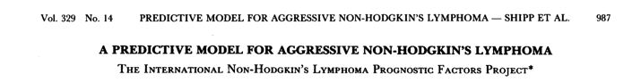
Efforts in 1993 Led to Defining the International Prognostic Index based on Clinical Characteristics
To develop a better prognostic-factor model for aggressive non-Hodgkin's lymphoma 16 institutions and cooperative groups in the United States, Europe, and Canada participated pooled together approximately 2,000 patients with complete data
The step-down regression analysis of overall survival in the training sample evaluated 12 variables.
A Predictive Model for Aggressive Non-Hodgkin's Lymphoma
NEJM 1993

Slide 6
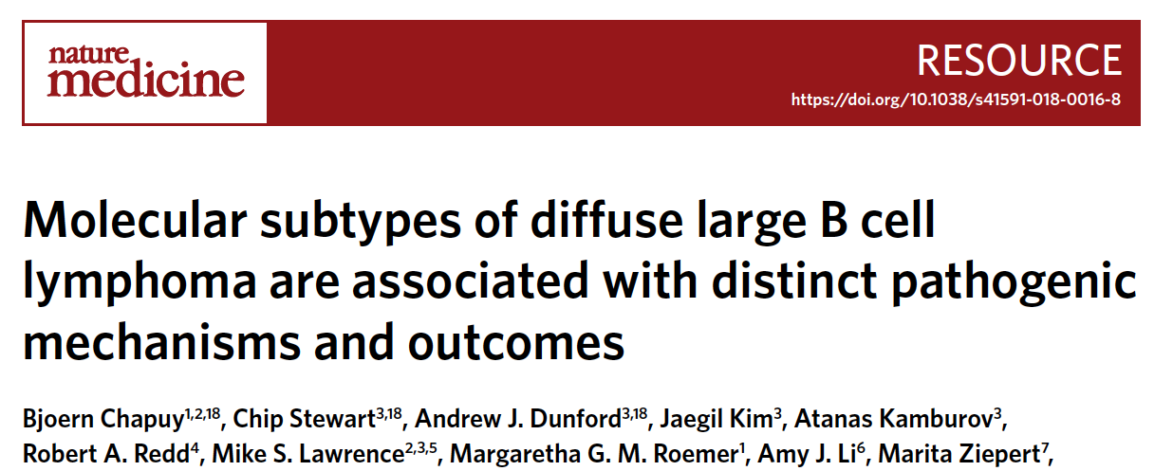
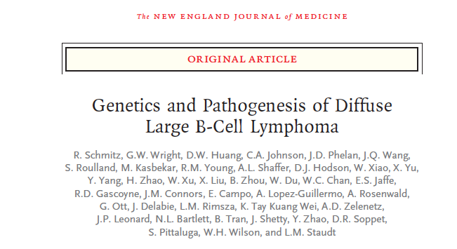
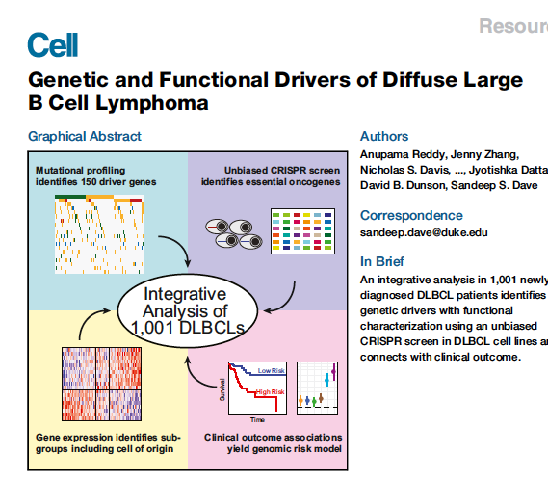
Efforts in 2019 Are Leading Toward Definitions of Novel Prognostic Subgroup Classifications Utilizing Genomics
Unsupervised (n=~300)
Non-negative matrix factorization
Semi-supervised (n=~560)
Seed based genetic algorithm
Supervised (n=~1000)
Cox elastic-net regression
Notes:
Schmitz et al
Chapuy et al
Reddy et al

Slide 7
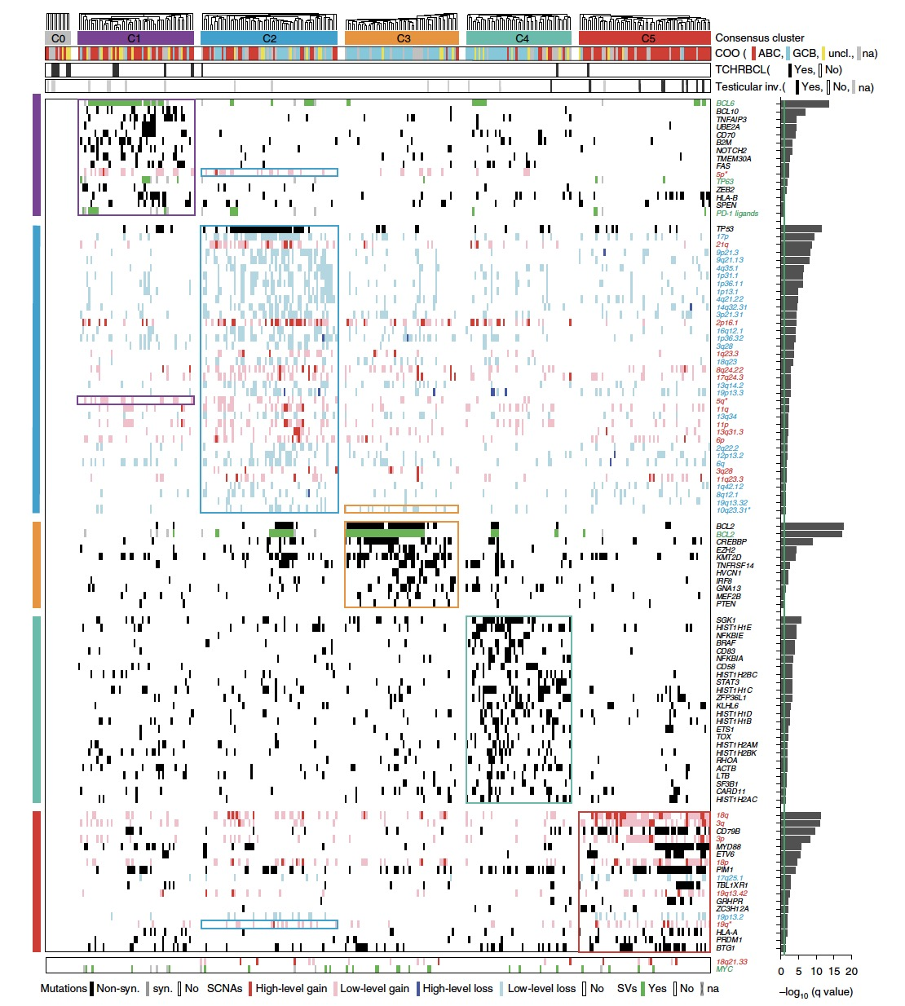
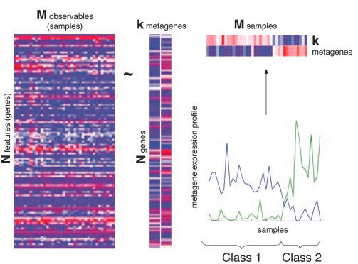
Novel Molecular Methods Require Statisticians and Computational Biologists
Chapuy et al (N = ~300)
Unsupervised approach utilizing Non-negative Matrix Factorization (NMF)
Approximate A ~ W H with a cost function:
Define clusters using basis
A
Chapuy et al., Cell 2018

Slide 8
Genentech has run a few 1L DLBCL clinical trials…
Question: Can we reproduce the results from these methods and inform new clinical trial development?
Trial | Phase | Indication | N
MAIN | III | 1L DLBCL | 787
GOYA | III | 1L DLBCL | 1418
CAVALLI | IB/II | 1L DLBCL | 211
A few of the larger trials we have RNA-Seq or Genomic data on…

Slide 9
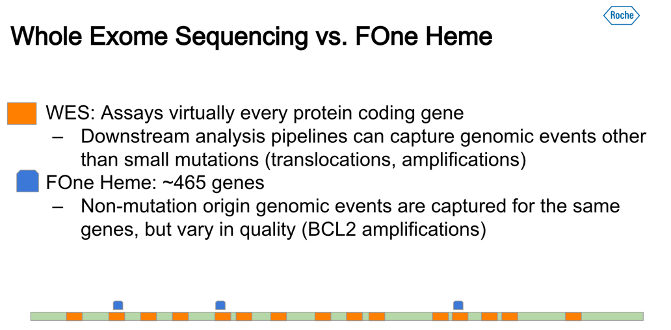
Eugene Kim

Slide 10

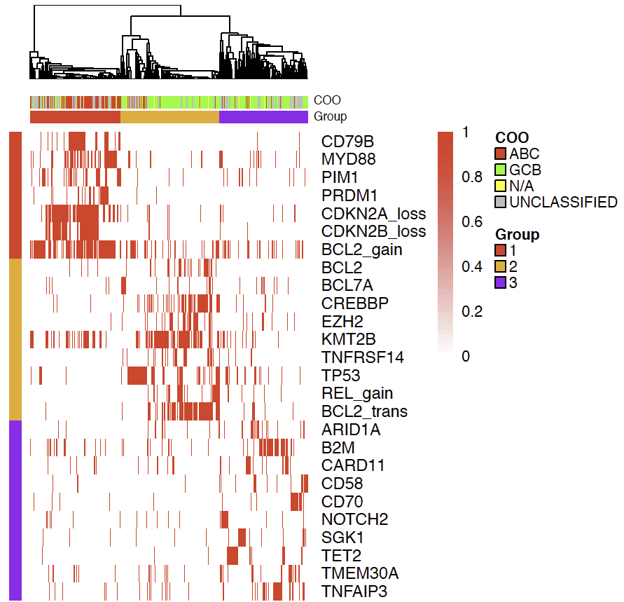
Recapitulation of NMF clusters by using FOne Heme in GOYA
GOYA
Chapuy et al
X
Associated match in Goya
KMT2D (MLL4) in Chapuy, KMT2B (MLL2) in Goya
Notable members of Chapuy clusters 2 and 4 not found in Goya
Eugene Kim

Slide 11
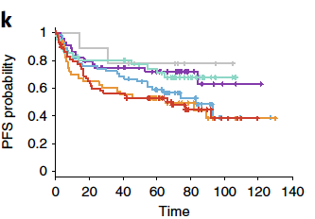
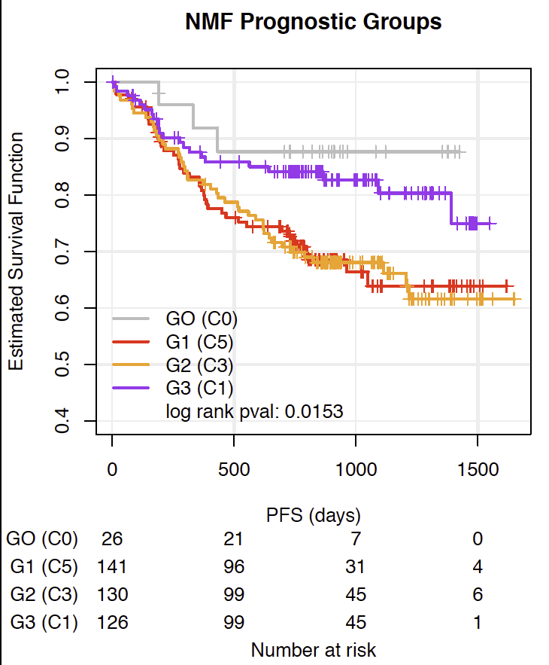
Recapitulation of Survival Profiles (PFS) by NMF Clusters in GOYA
Chapuy et al
GOYA
C0
C4
C1
C0
C1
C3
C5
C2
C3
C5
Low-Risk Group
High-Risk Group
Eugene Kim

Slide 12
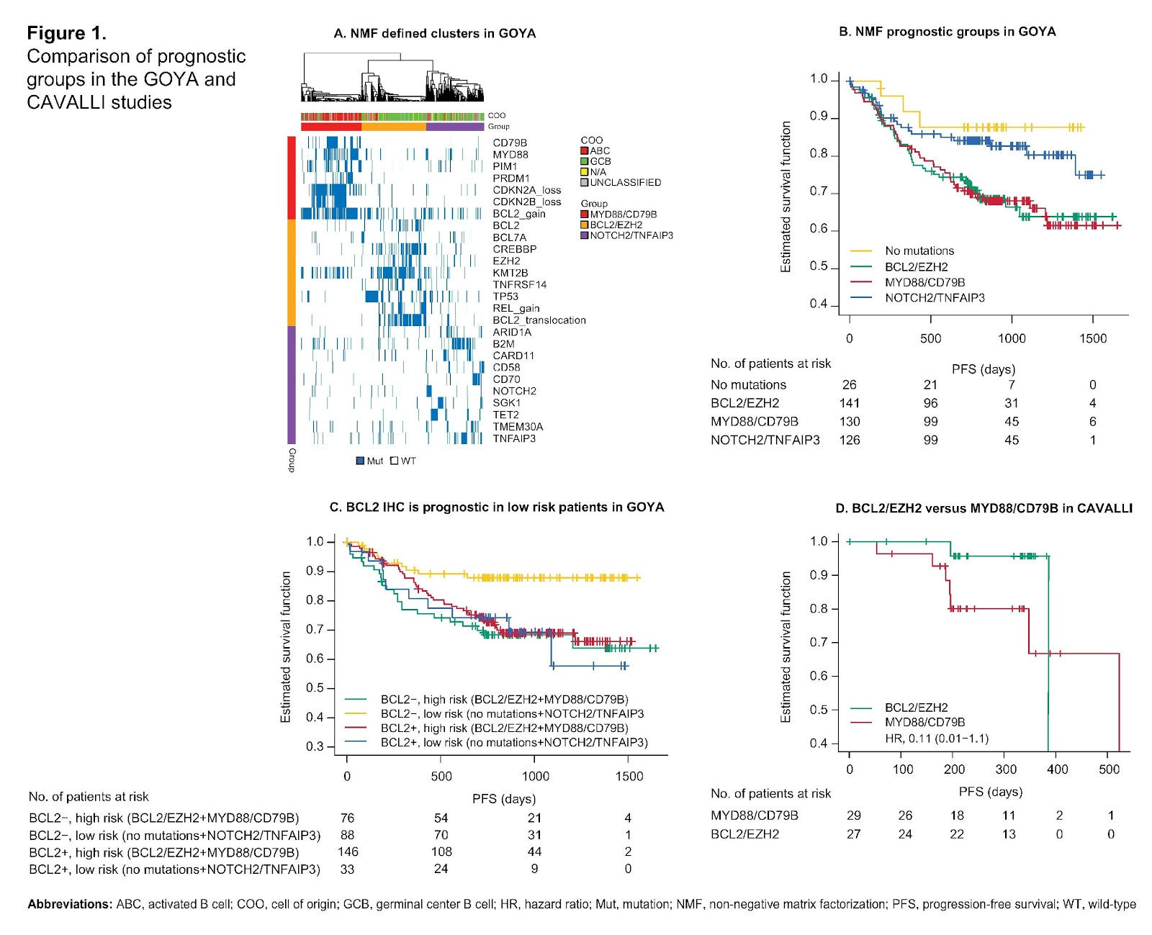
Recapitulation of molecularly defined subgroups
Utility of targeted mutational data from F1H in recapitulating molecular clusters, previously identified using WES, that further subclassify established prognostic groups such as COO and IPI, but not likely to be used in a trial today
Potential for utilizing novel genetic signatures as a means of identifying patients suitable for targeted therapies in the era of personalized health care
A trend towards improved survival outcomes for patients in the BCL2/EZH2 cluster upon treatment with the BCL2 inhibitor Venetoclax

Slide 13
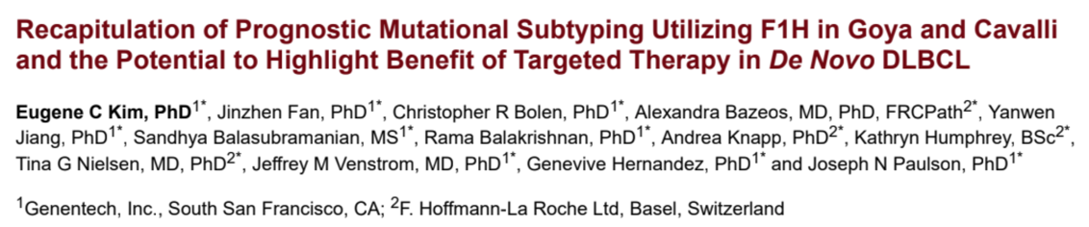
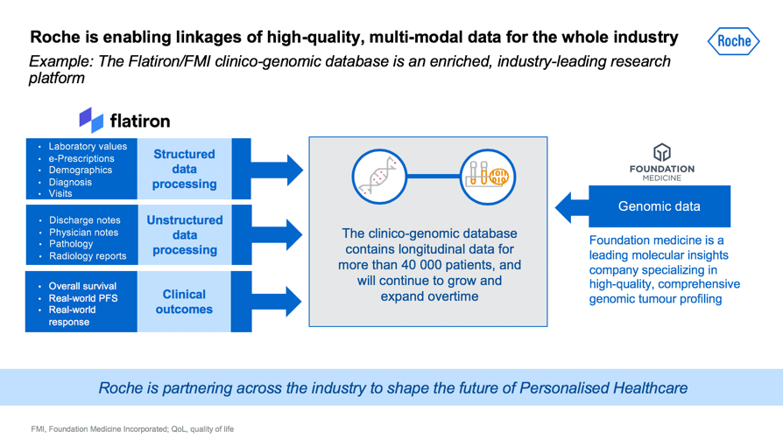
Next steps…
Finalize evaluation of prognostic benefit for genomic clusters on top of established prognostic clinical and biomarker features
Apply the NMF algorithm on the clinico-genomic database on 1L DLBCL patients for further validation…

Slide 14






Thankfully – new internal initiatives help with problems of old
Finding data and associated context (e.g. documentation)
Accessing data from different systems
Data sharing culture – “my” data, not “our” data
Inconsistent storage approach for managing data
Challenge to find documentation
Lack of identifiers for re-linking (patient/sample) and properly tracking data (dataset)

Slide 15
Along the way…
we had long term re-use in mind
Workstreams
Generate Datamart
Identify prognostic subgroup(s)
Inform pipeline + disease biology
Patient reported outcomes
Safety
A
B
C
D
E
Create a NHL data mart of legacy clinical trials in a way that will be easily analyzable
Capacity building with historical studies and genomic data
Find subgroups of patients who have High Unmet Medical Need (UMN) with available therapies
Test the hypotheses brought forward by that will inform strategic or trial design decisions
Evaluate patient reported outcomes from multiple studies
Correlation of safety outcomes with baseline factors, patient characteristics, and efficacy.
Patient-centric approach with potential to incorporate genomic data
Identify actionable patient subset(s)
Organized a team of statisticians, (computational) biologists, clinicians, curators, integrators, etc…

Slide 16
Statisticians can be the stewards
Trial | Phase | Indication | N
MAIN | III | 1L DLBCL | 787
GOYA | III | 1L DLBCL | 1418
GALLIUM | III | 1L FL | 1400
CAVALLI | IB/II | 1L DLBCL | 211
CONTRALTO | II | RR FL | 163
PRIMA | III | 1L FL | 1217
SABRINA | III | 1L FL | 410
GADOLIN | III | RR FL | 396
Data is an asset
> 6,000 patients
~1K RNA-Seq samples
~1K F1Heme samples
~2k Imaging PET CT

Slide 17
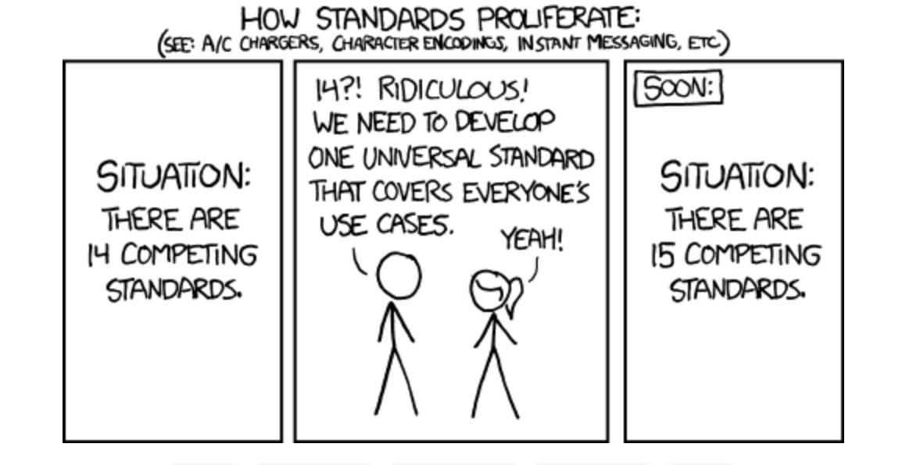
“The best thing about standards is that there are so many to choose from”
xkcd
Notes:
Biggest pain point for us: harmonization and standardization
Disease definition is constantly changing and there are so many synonyms and clinical studies is happening over so many sites, doctors that we have had issues with
Specificity (left lung vs. lung vs lower respiratory tract vs. lobe)
Research is changing how we define disease ex: Breast cancer, her2-, TNBC,
New data types are exciting, but require full understand and standardization in order to be incorporated
Do we wait for CDISC to create the standard for us, or do we create our own standard for now and then wait for them to come up with something and then switch to theirs?
Standards are a neverending job

Slide 18
Acknowledgements
Jane Fridlyand
Tina Nielsen
Eugene Kim
Jemma Fan
Nelson Kinnersley

Slide 19
Doing now what patients need next

Slide 20
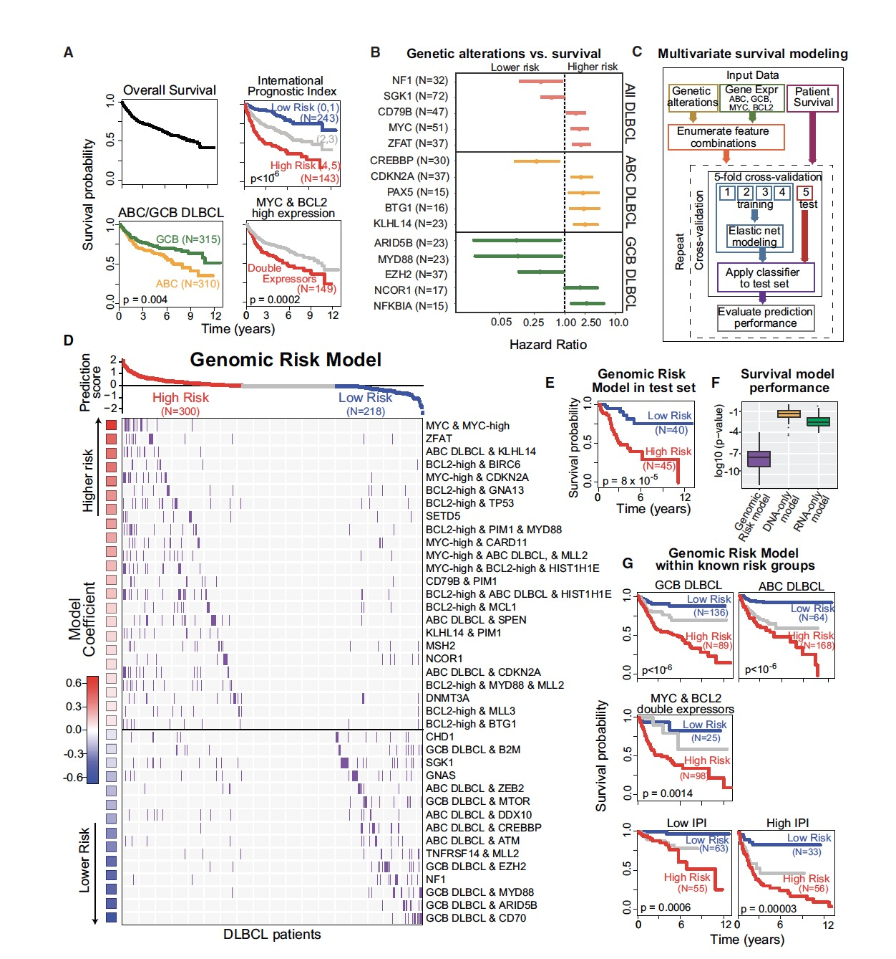
Novel Molecular Methods Require Statisticians and Computational Biologists
Schmitz et al (N = ~560)
Semi-supervised approach utilizing a seed based algorithm for a small subset of patients with particular mutations
CD79B+MYD88, NOTCH1, BCL6+NOTCH2 and BCL2 translocations + EZH2
Reddy et al (N = ~1000)
Supervised model based on an cox elastic-net regression
Enumerated feature combinations as potential covariates
Relative risk score:
Reddy et al., Cell 2017

Slide 21
GOYA (NCT01287741) Study Design
Global, randomised Phase III study in 1L DLBCL pts
Previously untreated DLBCL (N=1418)
Age ≥18 years
IPI ≥2 or IPI 1 not due to age alone or IPI 0 with bulky disease (one lesion ≥7.5cm)
Adequate hematologic function
≥1 bi-dimensionally measurable lesion
ECOG PS ≤2
G-CHOP arm
G 1000mg C1 D1/8/15 and C2–8 D1
CHOP 6 or 8 cycles every 21 days*
Rand
R-CHOP arm
R 375mg/m² C1–8 D1
CHOP 6 or 8 cycles every 21 days*
Randomization stratified by planned number of CHOP cycles, IPI and geographic region
Primary endpoint | Secondary endpoints Exploratory imaging endpoints
PFS† (INV-assessed) | PFS† (IRC-assessed) OS, EFS, DFS, DoR ORR/CR† at EOT (+/– FDG-PET) Safety | Quantitative PET metrics (IRC assessed)
Data cut-off: January 31, 2018
Median follow-up: 3.9 years
*Number of cycles pre-planned in advance for all pts at each site †Response and disease progression assessed using the Revised Response Criteria for Malignant Lymphoma (Cheson BD et al. 2007) R-CHOP, rituximab + CHOP; G-CHOP, obinutuzumab + CHOP; (Vitolo et al, 2017)

Slide 22

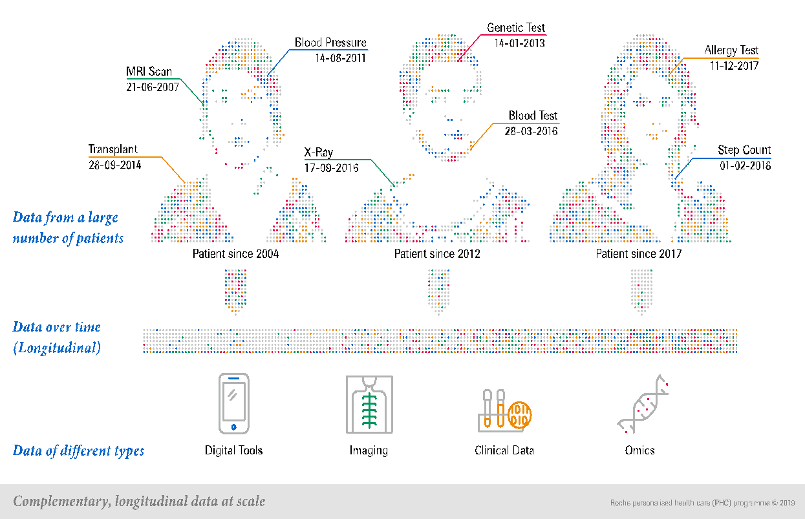


Roche is enabling linkages of high-quality, multi-modal data for the whole industry
Example: The Flatiron/FMI clinico-genomic database is an enriched, industry-leading research platform
Laboratory values
e-Prescriptions
Demographics
Diagnosis
Visits
Structured data processing
Genomic data
Unstructured data processing
Discharge notes
Physician notes
Pathology
Radiology reports
Foundation medicine is a leading molecular insights company specializing in high-quality, comprehensive genomic tumour profiling
The clinico-genomic database contains longitudinal data for more than 40 000 patients, and will continue to grow and expand overtime
Overall survival
Real-world PFS
Real-world response
Clinical outcomes
Roche is partnering across the industry to shape the future of Personalised Healthcare
Notes:
Our approach to linking and curating data extends beyond Flatiron. Data from Flatiron are being linked with data from Foundation Medicine to create an industry-leading clinico-genomic database of high-quality, multi-modal data that has the potential to shape research across the whole industry.
The clinic-genomic database currently brings together data from more than 40,000 patients, linking individual patient’s genomic data with structured and unstructured data from their electronic health records. The database will expand over time.
Access to this vast, linked, high-quality dataset has the potential to help shape the future of Personalised Healthcare, by allowing an understanding of patient outcomes based on their genetic profile, which will ultimately result in the development and implementation of a truly personalised clinical approach.

